Slide 1

Gymnetics Sprint 2
Team Byte Squad

Slide 2
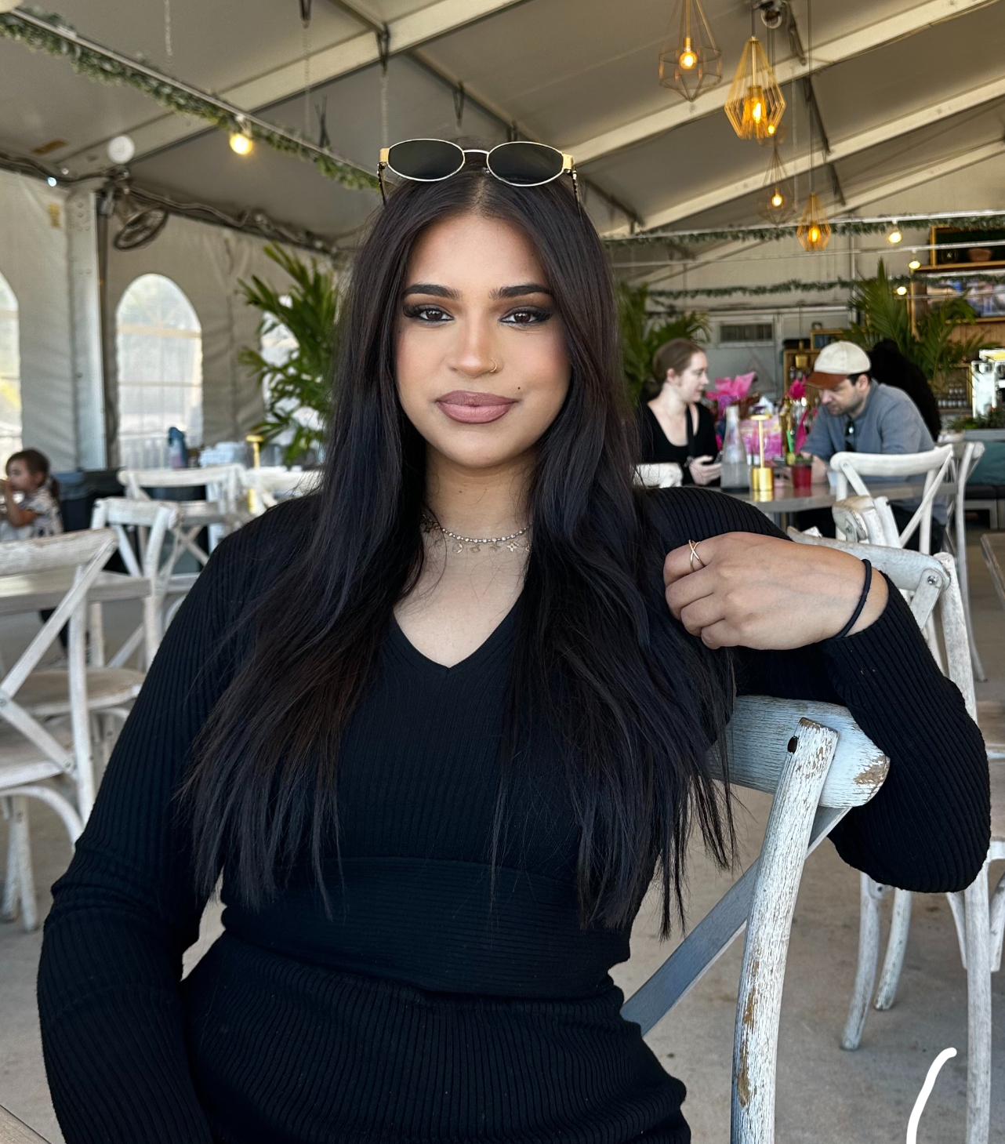


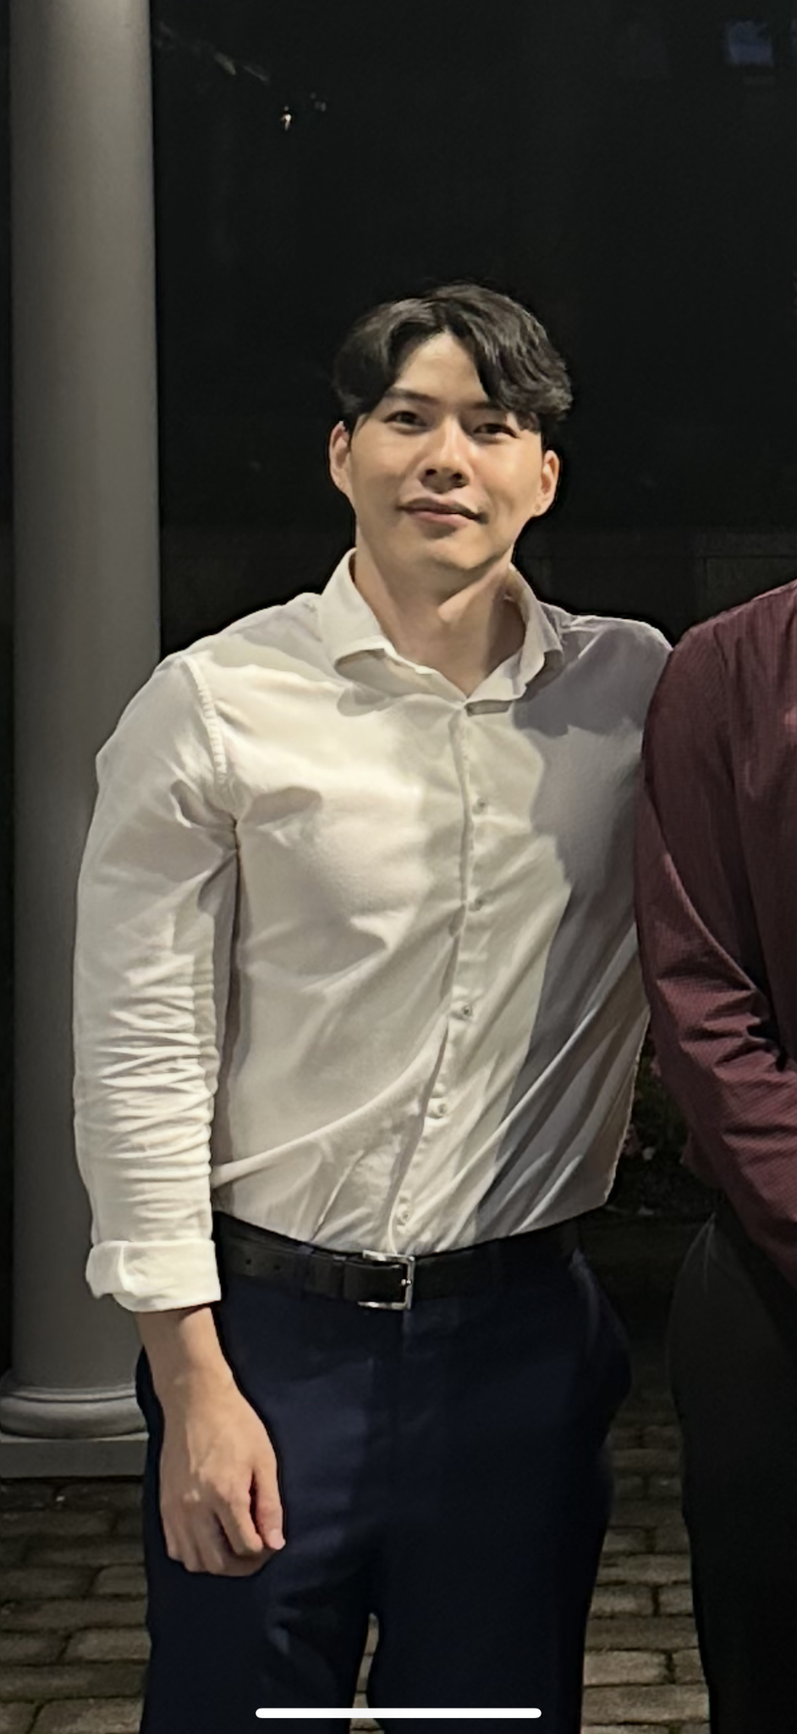
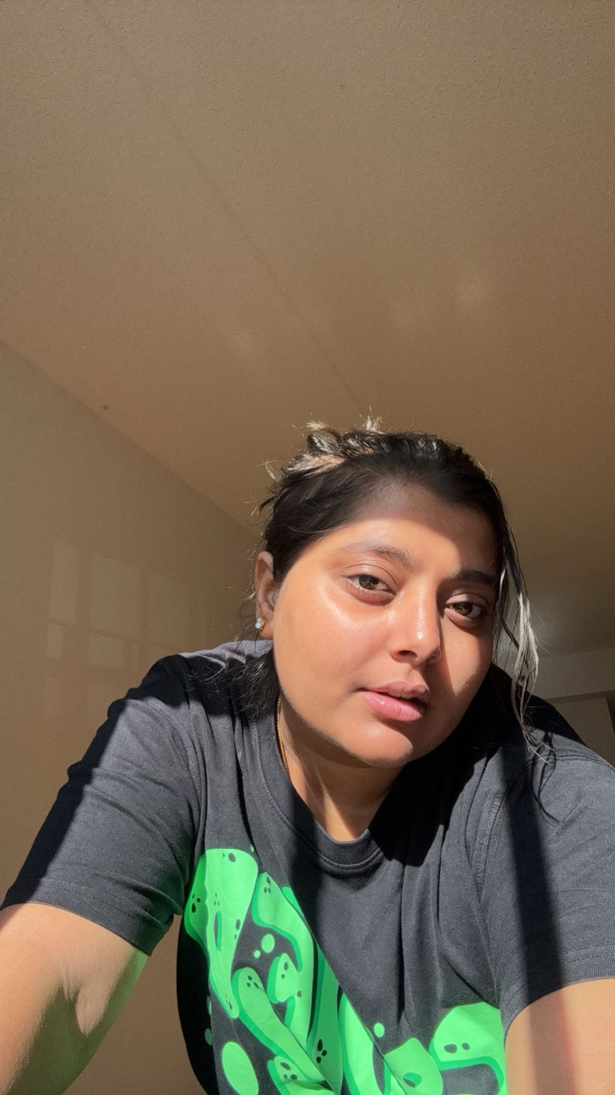
Meet Gymnetics
Samiha Shareef
Adam Miftahelidrissi
Marlen Cuevas Duarte
Jia Lau
Diya Ashish Patel

Slide 3
Improvements from Professor Feedback
Better representation of product backlog & test cases
More accurate burndown chart
Updated & more specific user stories
Put all artifacts in the assigned repo, make links clickable, and add a direct demo link.

Slide 4
Project Description
Team: ByteSquad
Project Description: The Gymnetics web application is a smart supplement, nutrition, and fitness planning platform that generates AI-powered supplement recommendations and workout routines tailored to each user’s goals, body metrics, and experience level. Unlike generic fitness programs or manual research, our application delivers customized plans instantly, helping users achieve results faster and more efficiently.
Benefit Outcomes:
Increased user adherence to personalized workout and supplement plans
Improved fitness goal tracking and progress monitoring
Streamlined onboarding through a guided quiz experience
Time-saving and confidence-boosting by eliminating the need for manual planning
User satisfaction from having expert-level guidance without needing a personal trainer
GitHub Link: https://github.com/htmw/2025Su-ByteSquad

Slide 5
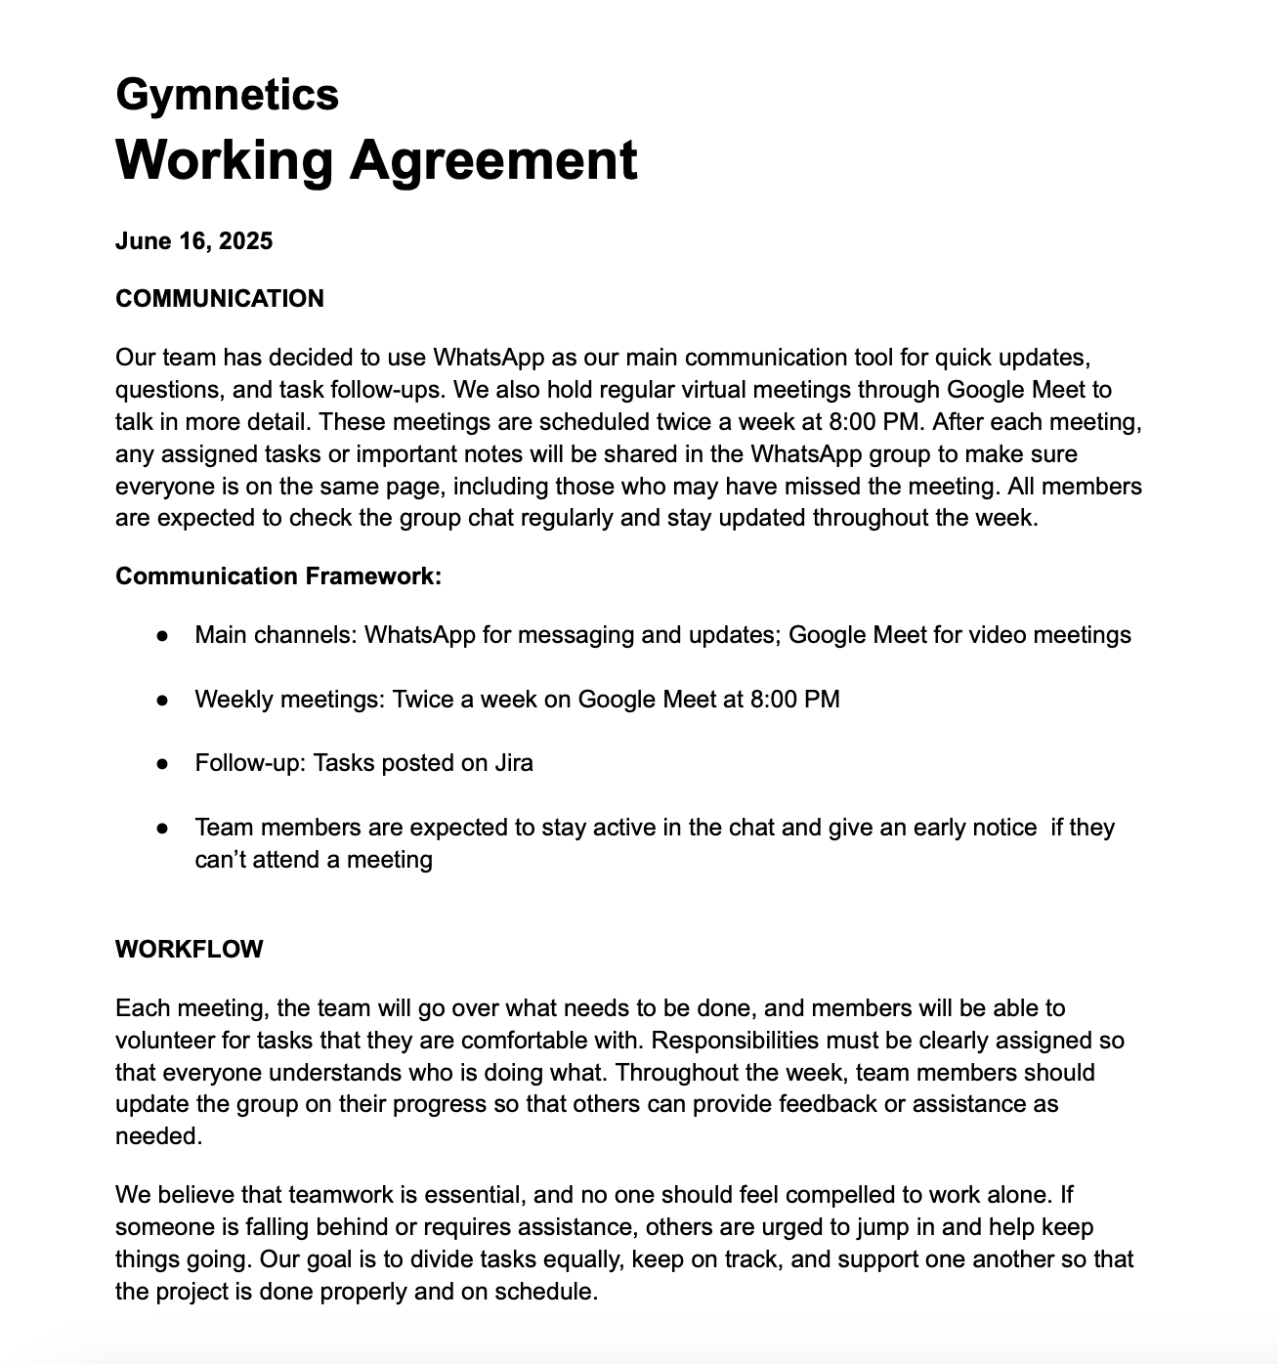
Working Agreement

Slide 6

PERSONA 1 - UNORGANIZED STUDENT
“I WANT TO LEAD A HEALTHIER LIFESTYLE WITHOUT EXTREME DIETING AND EXERCISE. I WANT TO BE CONSISTENT AND DISCIPLINED.”
GOALS
1
Build Lean Muscle Mass
2
Learn How to Weightlift
MARIA CASTRO
DETAILS
Eat Consistent & Healthy Meals
3
20 years old
5’5”, 135lbs
Full time student & part -time Bookkeeper
EXPERIENCE
PAIN POINTS
Beginner - only familiar with at home bodyweight workouts
Has only been to the gym a handful of times, inconsistent with workouts & getting enough meals in the day. Doesn’t know what to eat.
** Maria will input all her information (age, weight, height, and goals) and receive a 3 day workout split, macro breakdown, and supplement suggestions. She will receive reminders to log in her meals. The suggestions from the store will be daily multivitamins,creatine, and whey isolate or plant-based protein powders.

Slide 7
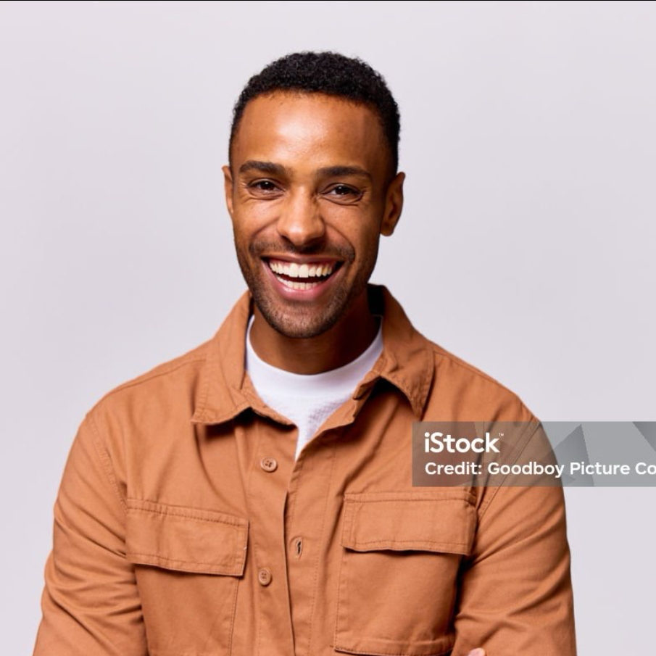
PERSONA 2 - AMATEUR BODYBUILDER
“I WANT TO BECOME A BODYBUILDER AND JOIN MY FIRST COMPETITION THIS YEAR. ”
MOTIVATIONS
1
Build Muscle Mass & Strength
2
Join bodybuilding competition
JAMES BROWN
DETAILS
Reach 210 lbs
3
28 years old
6’2”, 178 lbs
Retail Sales Associate
EXPERIENCE
PAIN POINTS
Intermediate - lifts often but doesn’t keep track of his nutrition & weight
Doesn’t have a consistent workout split, doesn’t know how to track macros & calories, not familiar with supplements
** James will input all his information (age, weight, height, and goals) and receive a 5 day workout split, macro breakdown, and supplement suggestions. The suggestions will be creatine, pre workout, mass gainer, fish oil , and whey isolate or whey blend protein powders.

Slide 8
MVP
The Minimum Viable Product (MVP) is the simplest version of our app that delivers core value to users.
Gymnetic MVP Features:
User Sign-up/Login
Profile: Add height, weight, fitness goals
Browse Supplements Store
Add to Cart
Mock Checkout (no payment yet)
Customized workouts and nutritional recommendations
This allows users to experience our fitness ecosystem from Day 1!

Slide 9
Tech Stack
Backend
Java
Spring Boot
AI Integration
Deepseek
Frontend
React
CSS
HTML
Database
MySQL
Third Party
AWS S3
Stripe

Slide 10
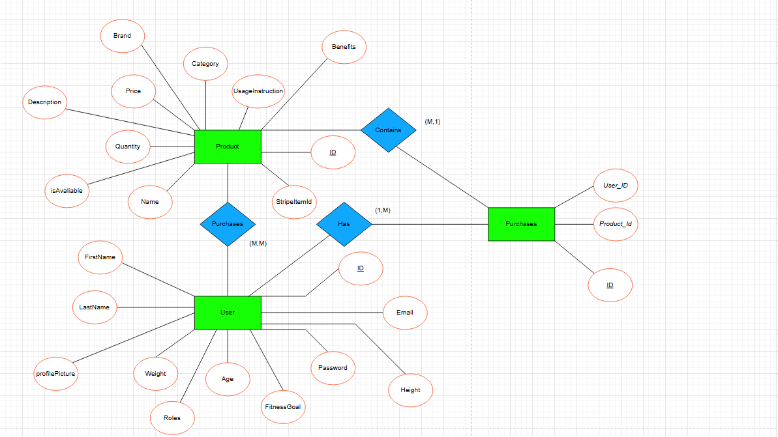
ER Diagram

Slide 11
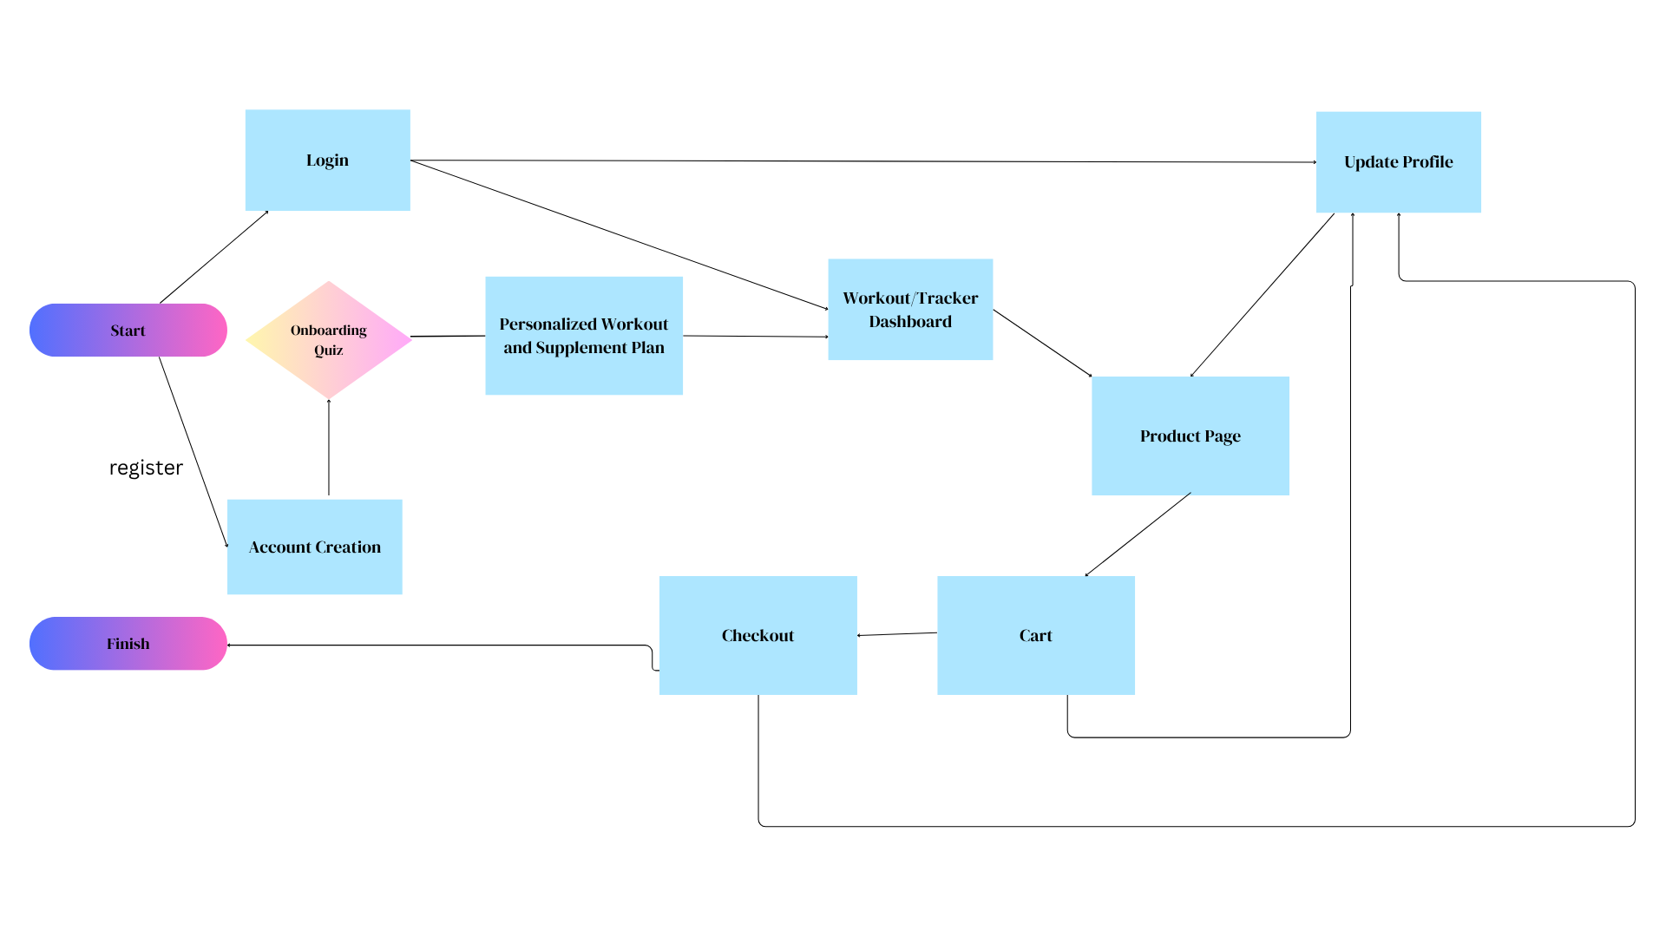
State Diagram

Slide 12
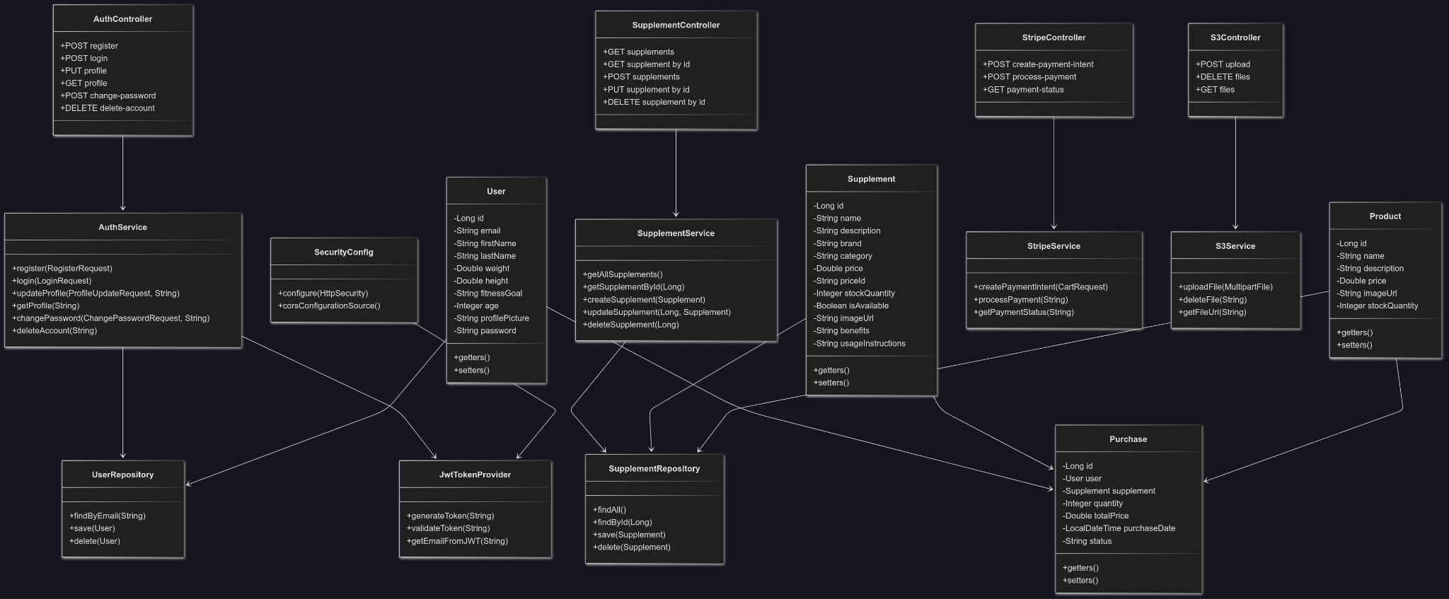
Class Diagram

Slide 13
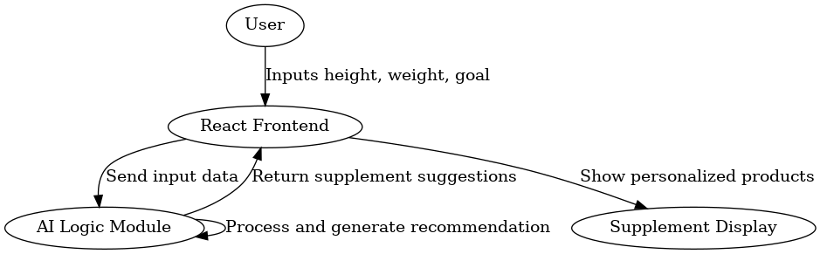
Sequence Diagram

Slide 14
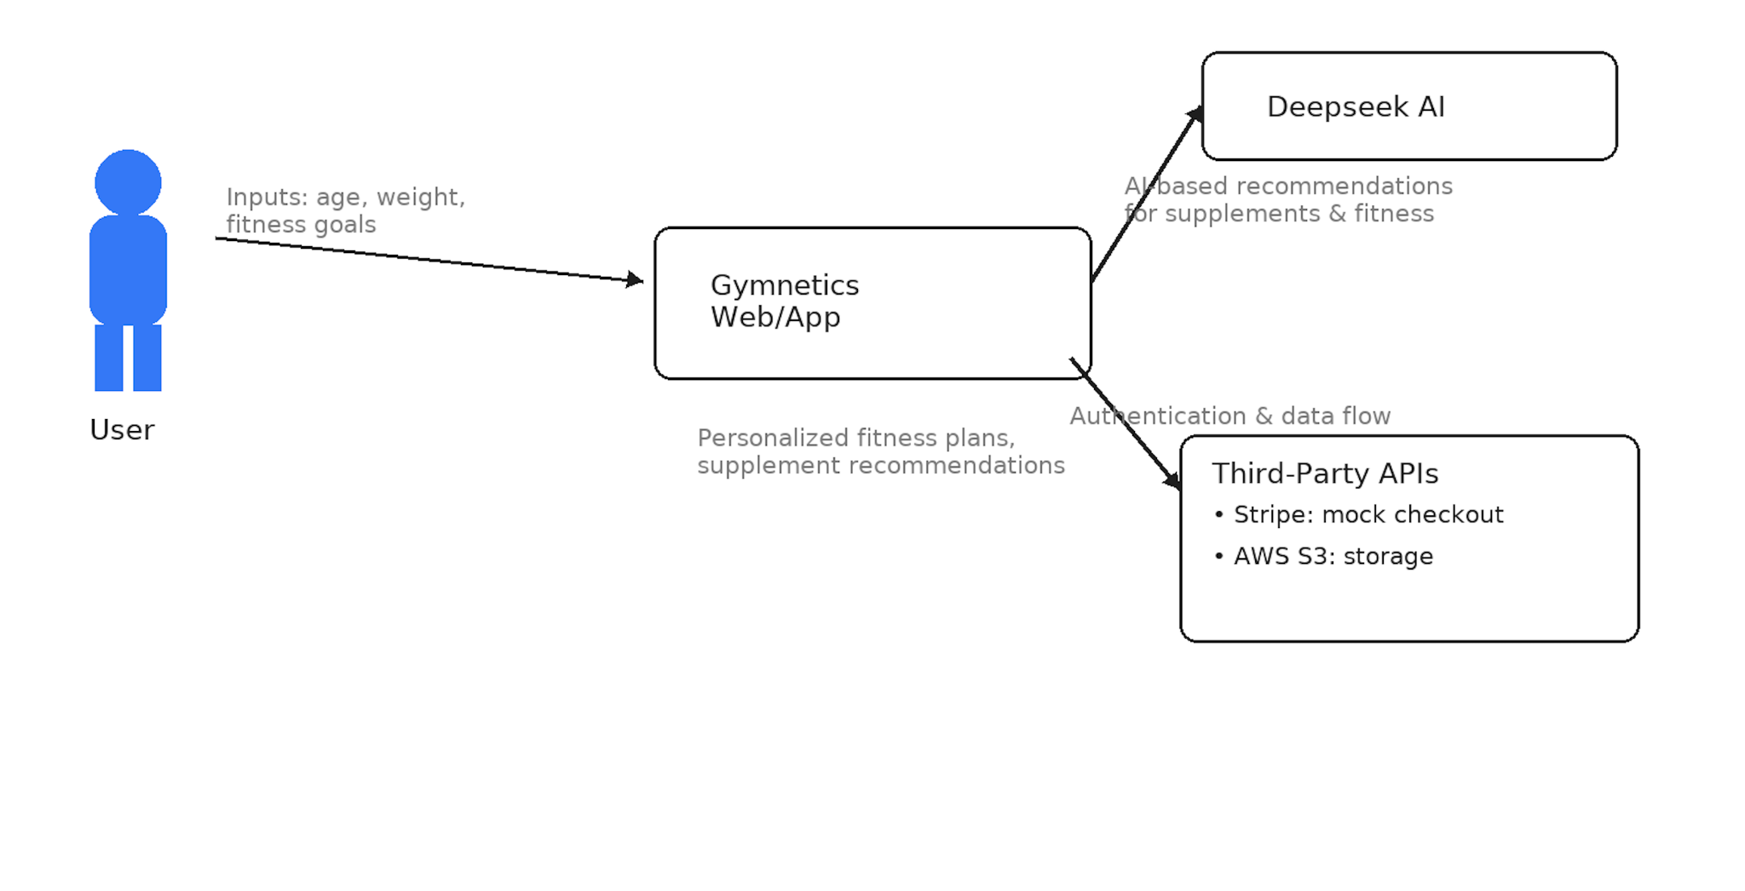
Context Diagram

Slide 15
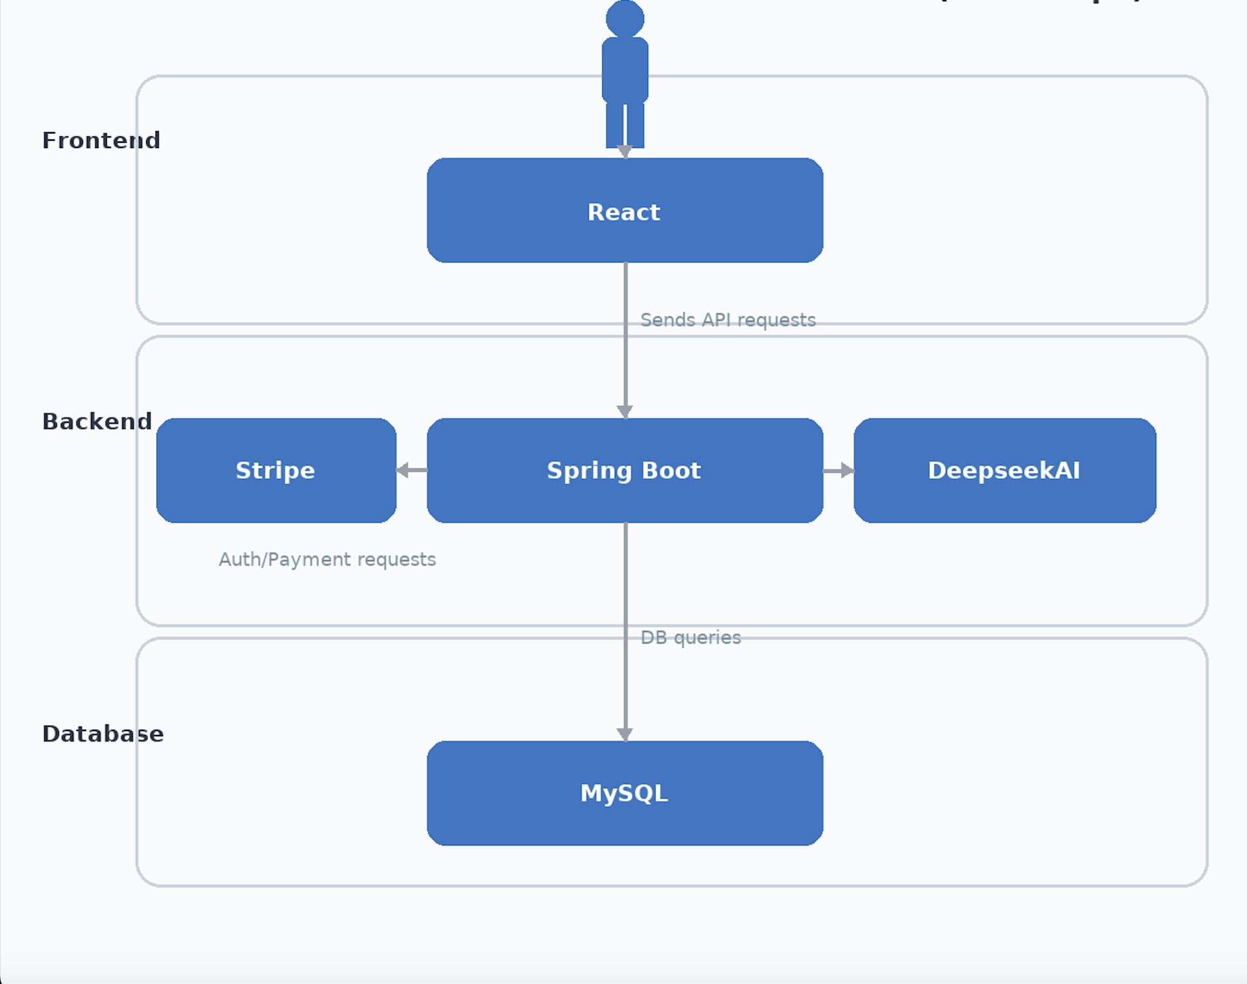
Architecture Diagram

Slide 16
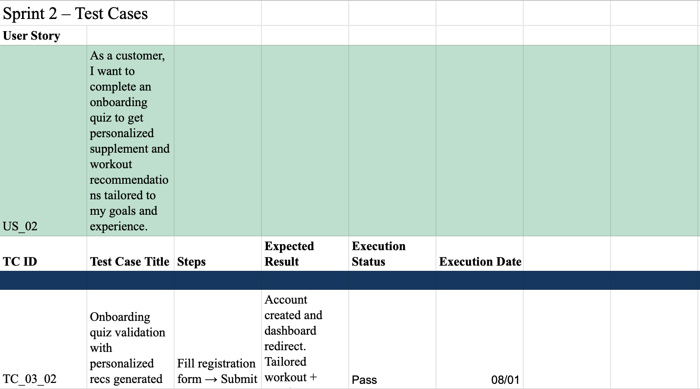
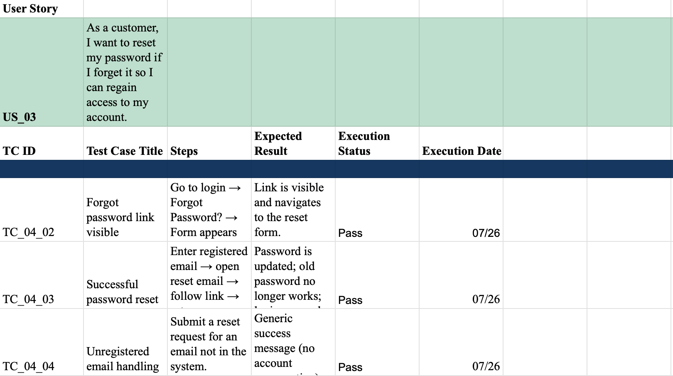
Test Cases w/ User Stories pt.1

Slide 17
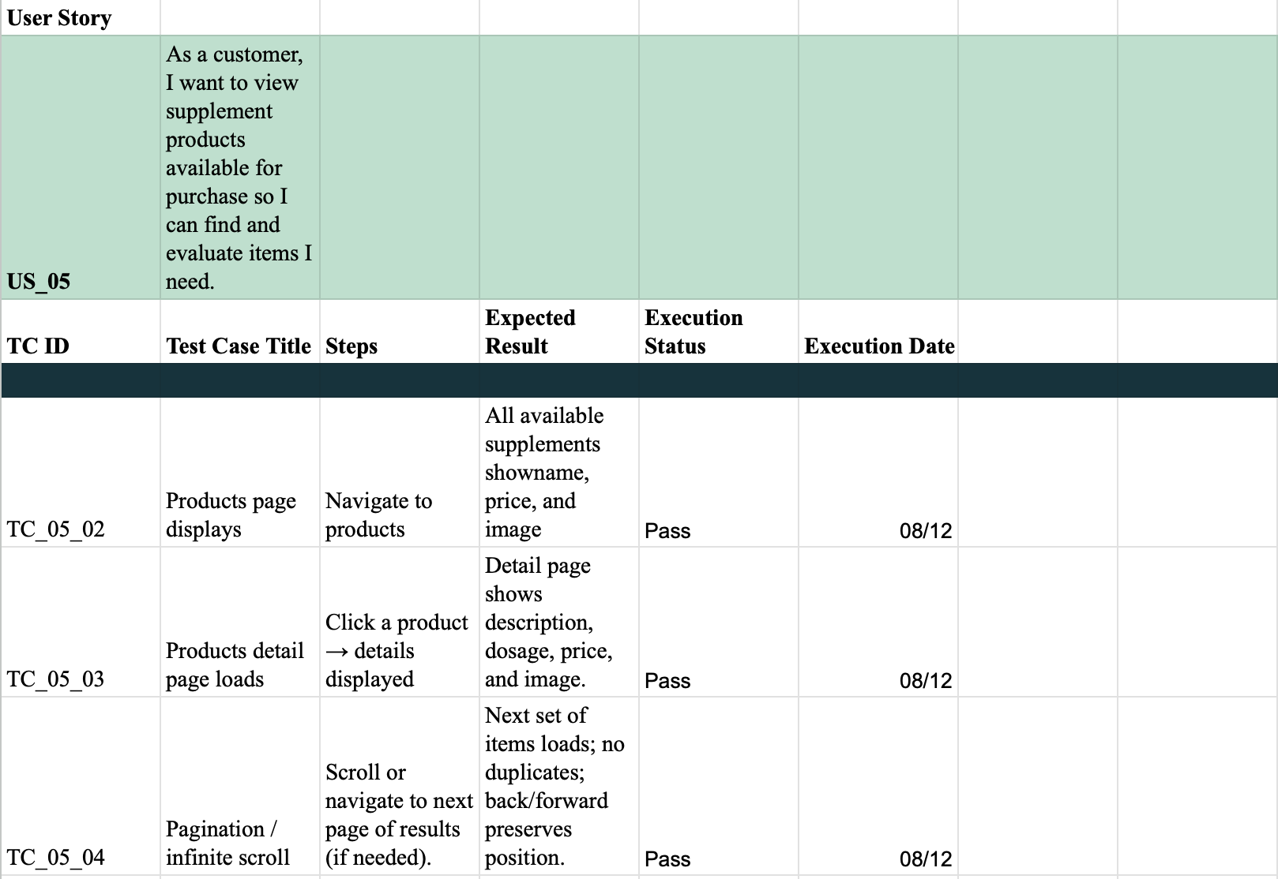
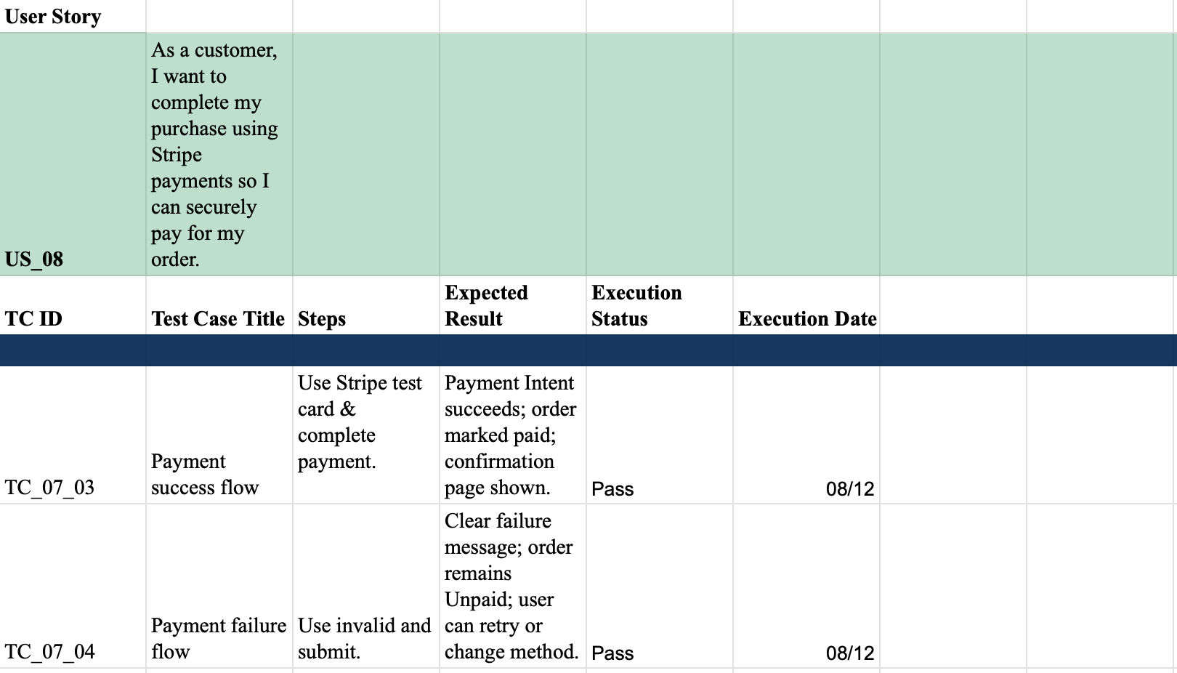
Test Cases w/ User Stories pt.2

Slide 18
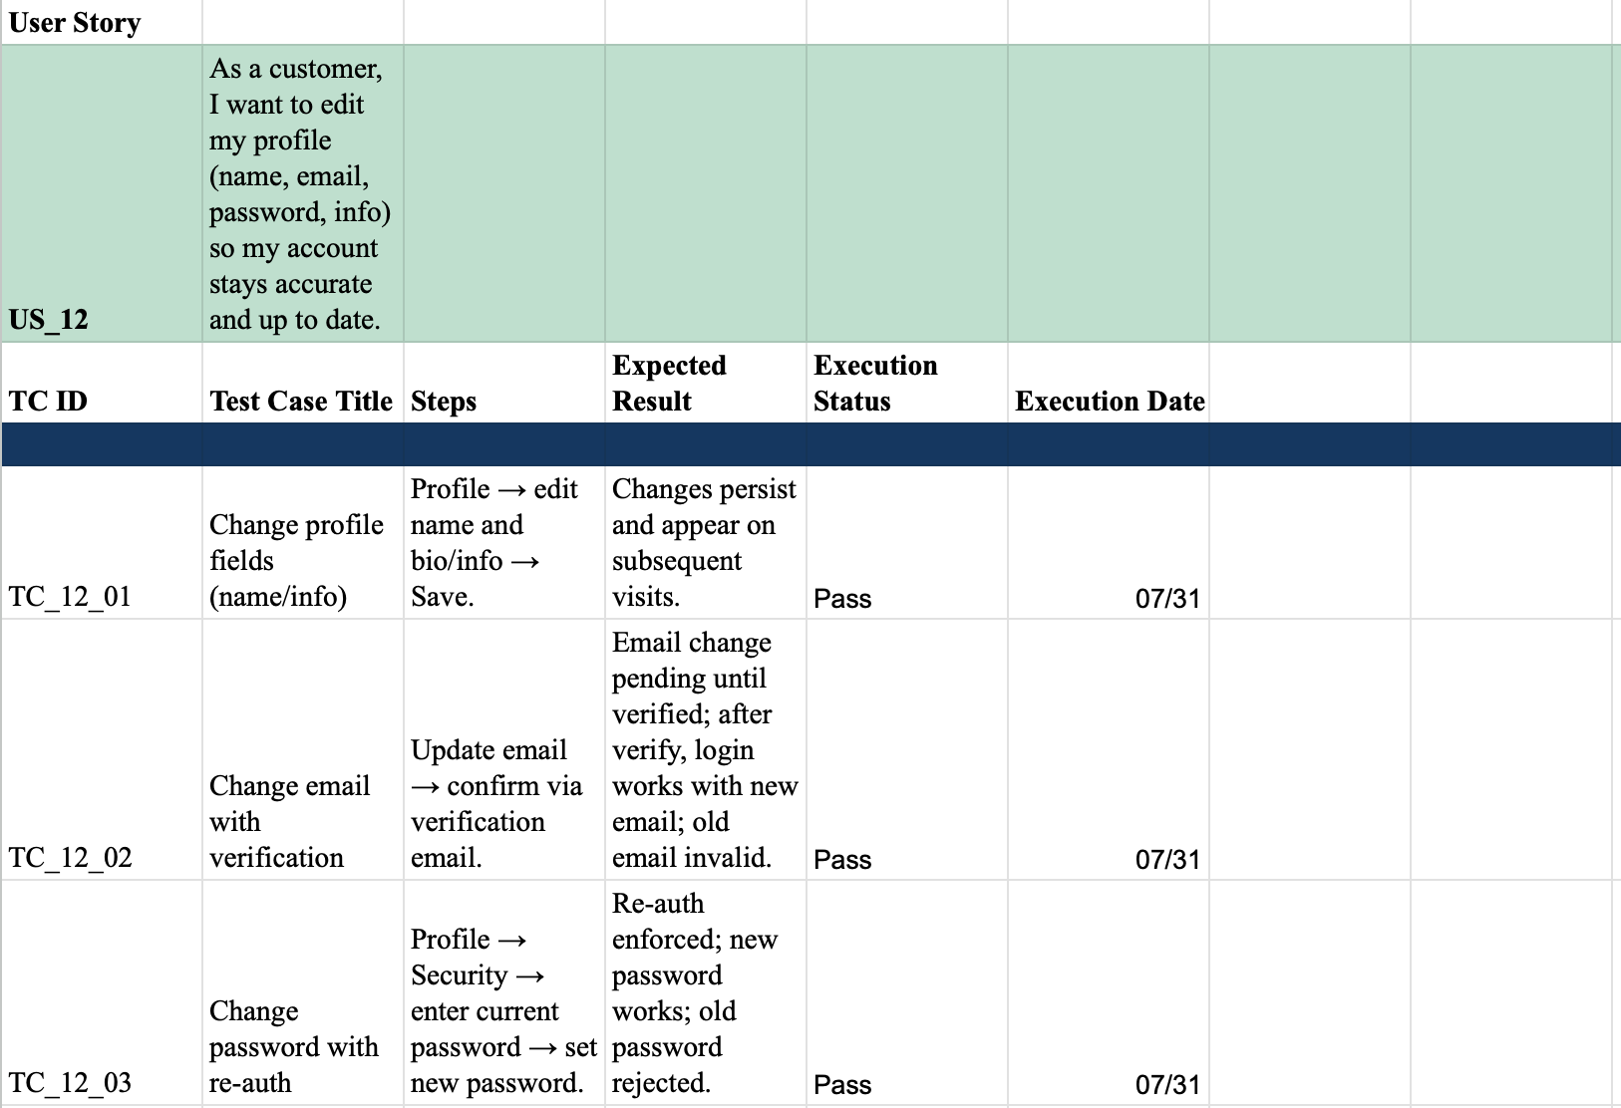
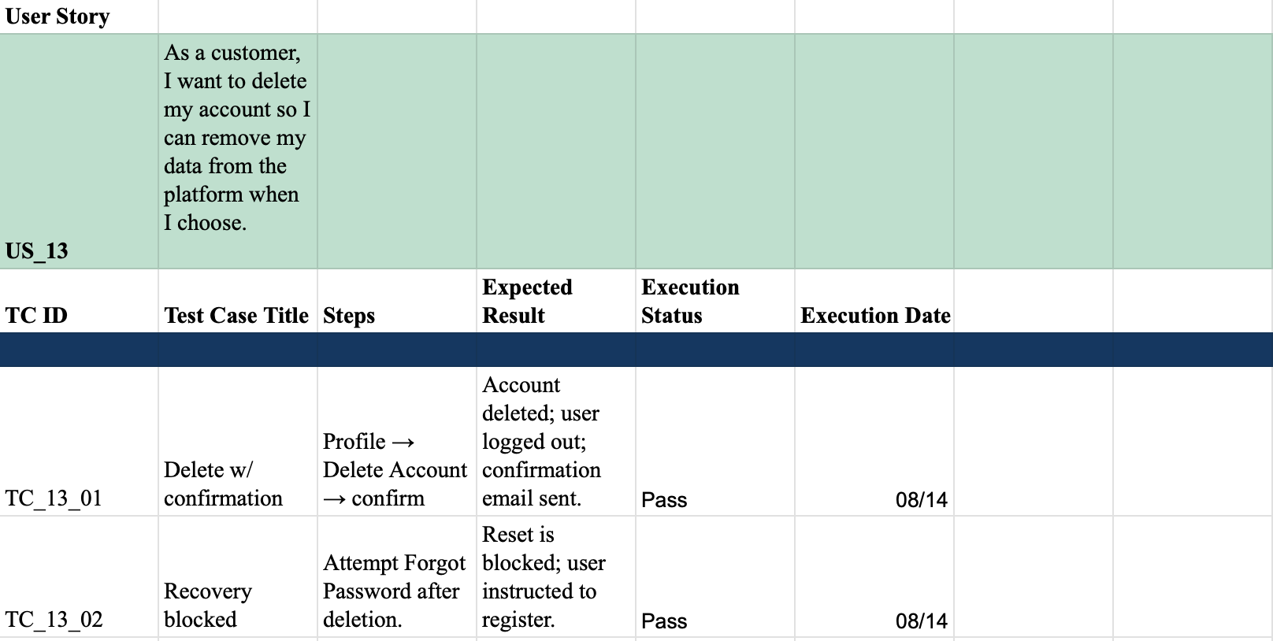
Test Cases w/ User Stories pt.3

Slide 19
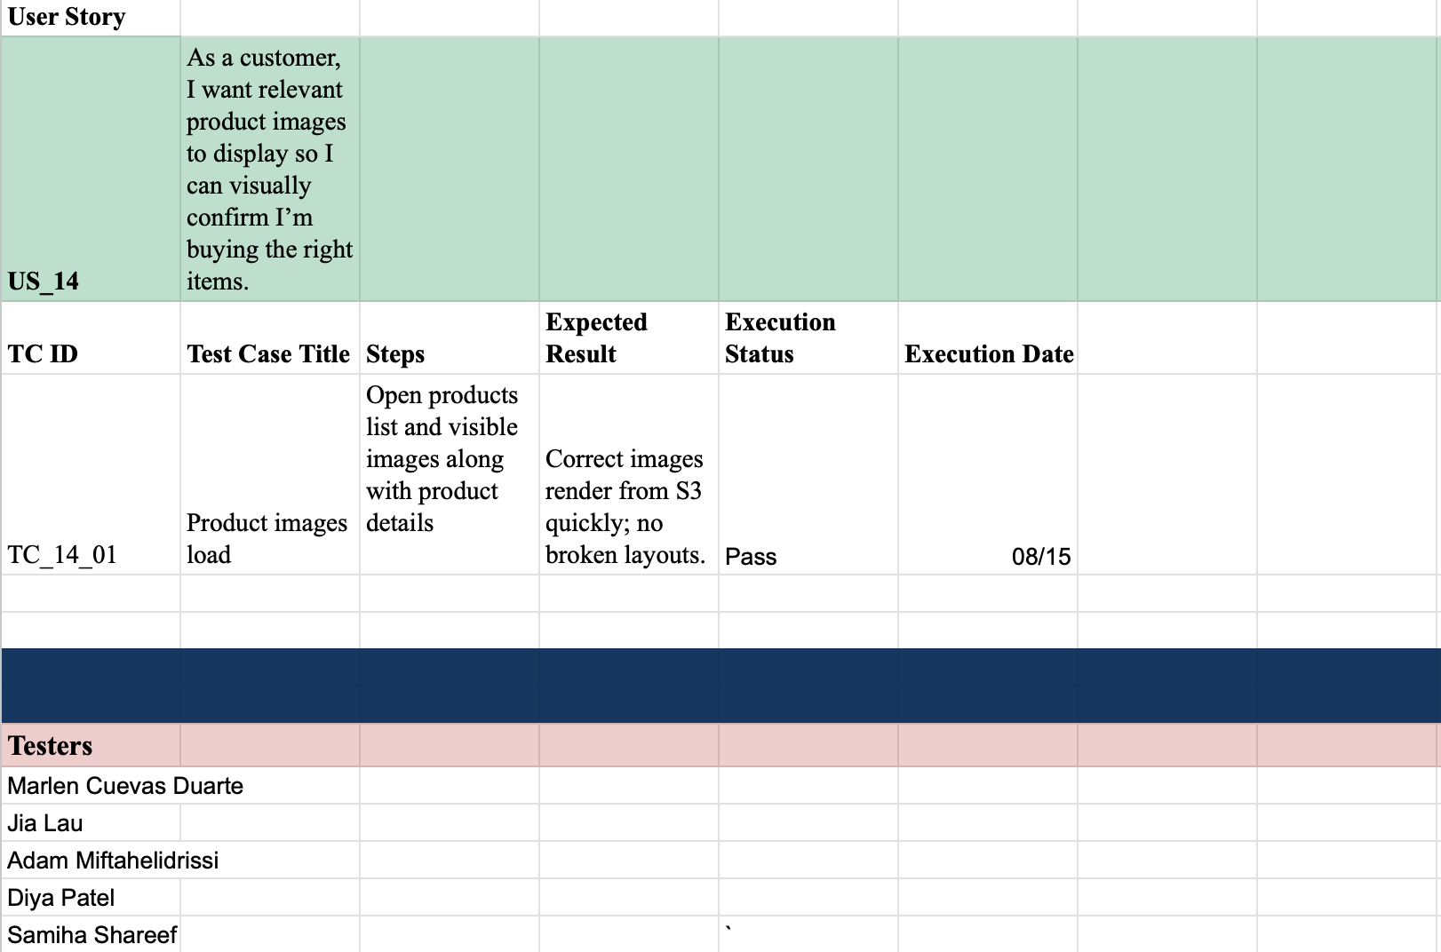
Test Cases w/ User Stories pt.4

Slide 20
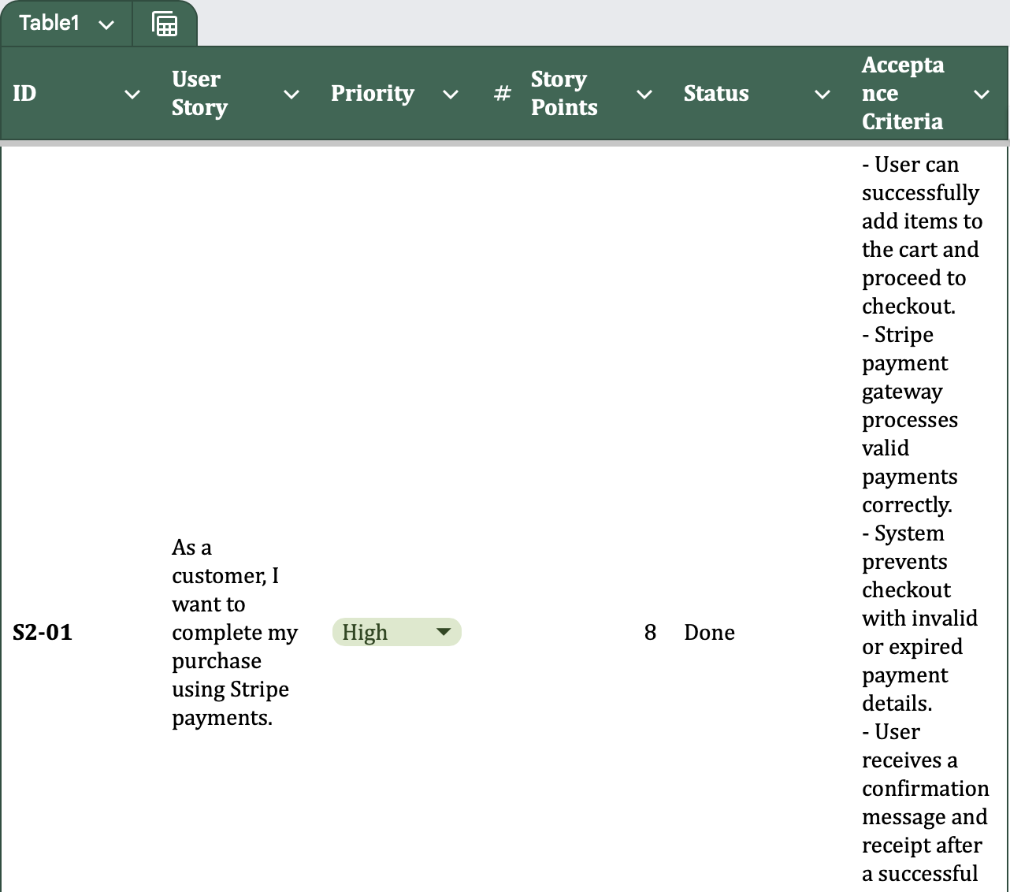
Sprint Backlog

Slide 21
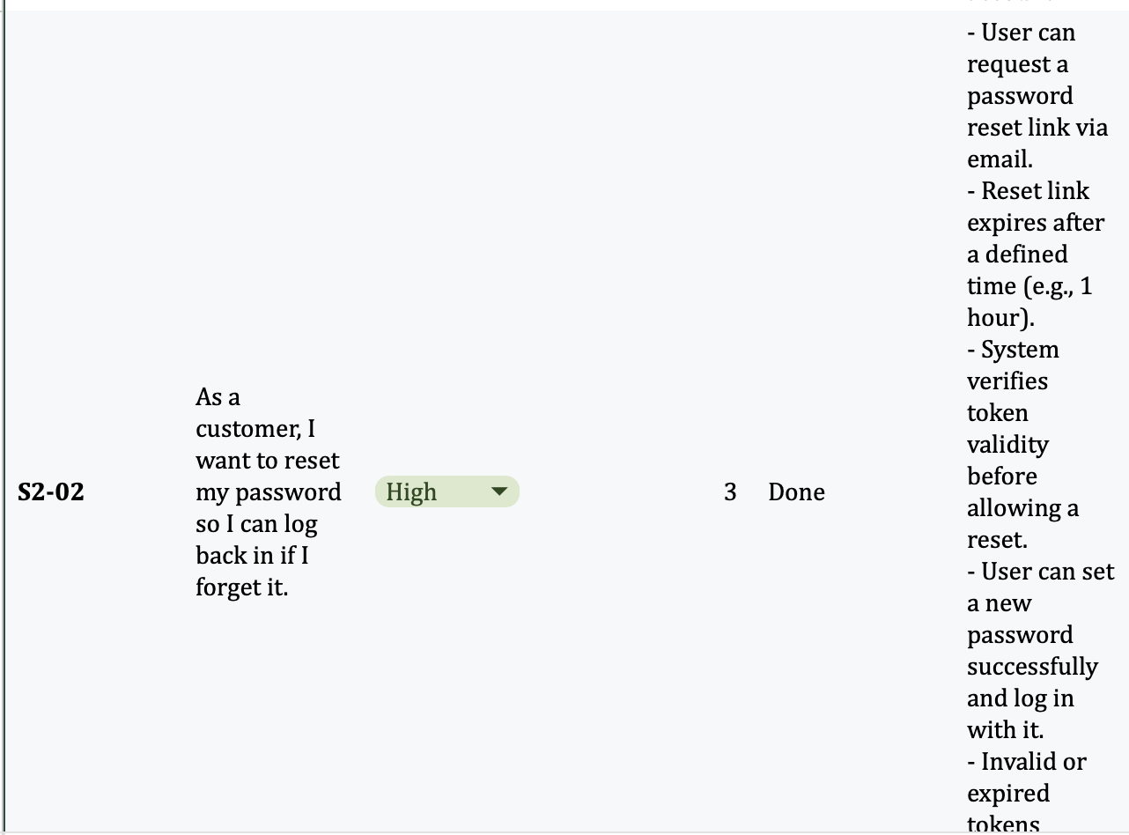
Sprint Backlog Pt.2

Slide 22
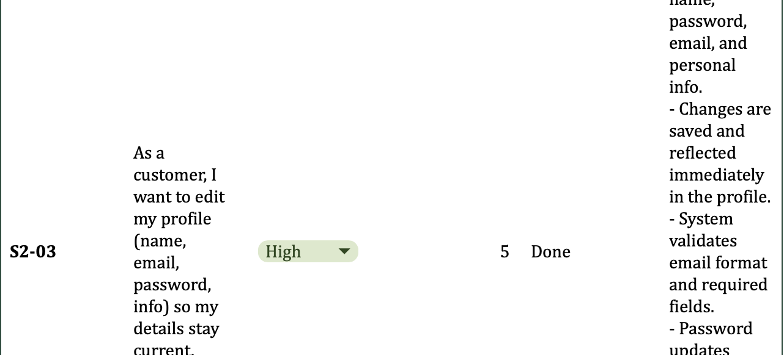
Sprint Backlog Pt.3

Slide 23
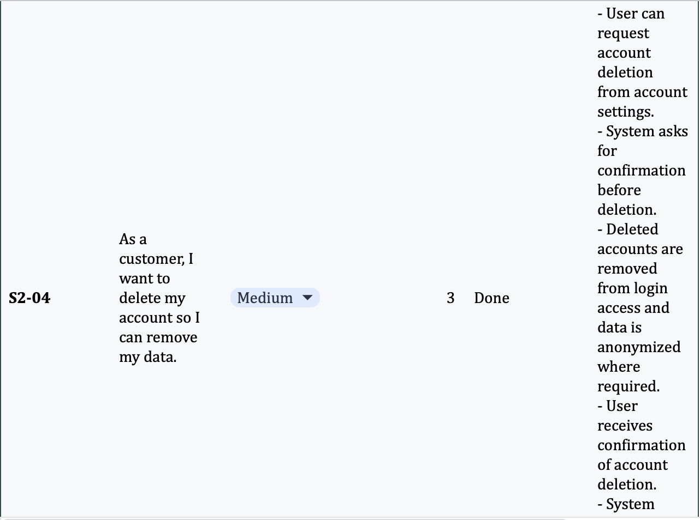
Sprint Backlog Pt.4

Slide 24
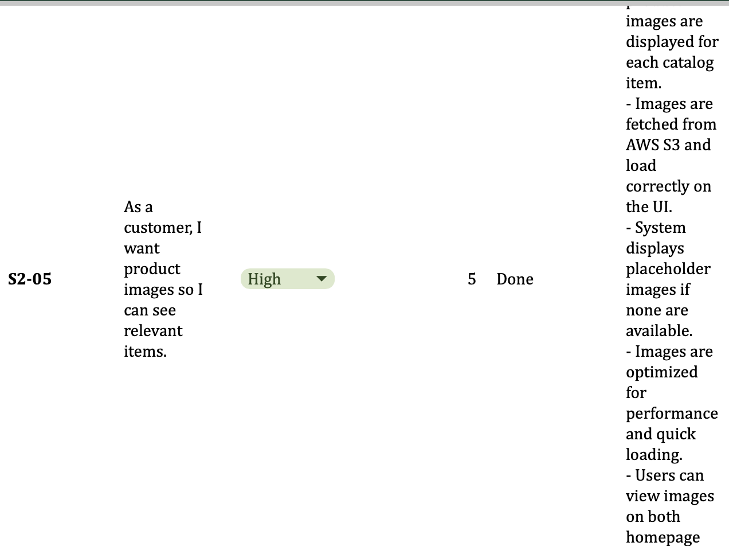
Sprint Backlog Pt.5

Slide 25
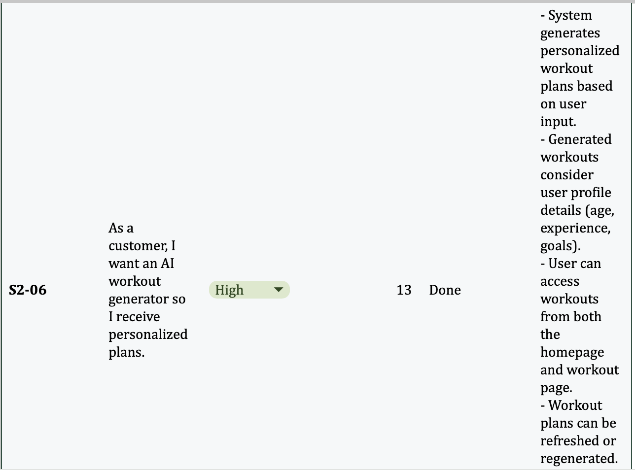
Sprint Backlog Pt.6

Slide 26
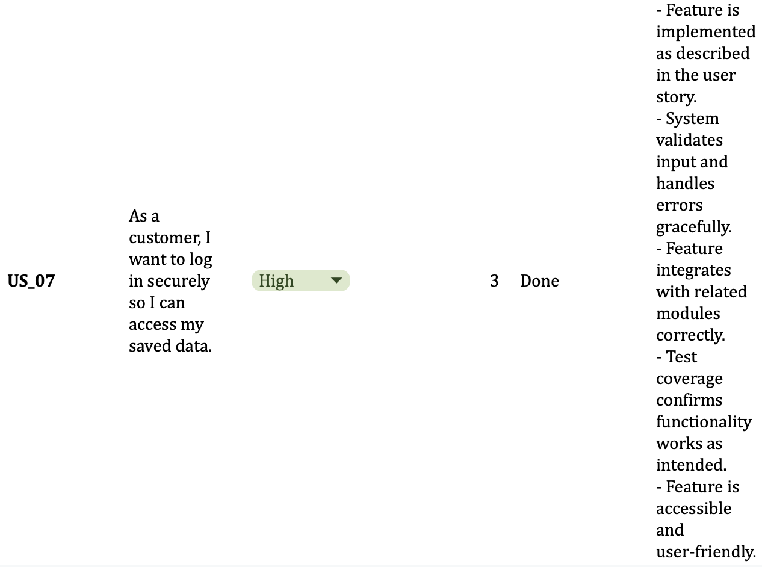
Sprint Backlog Pt.7

Slide 27
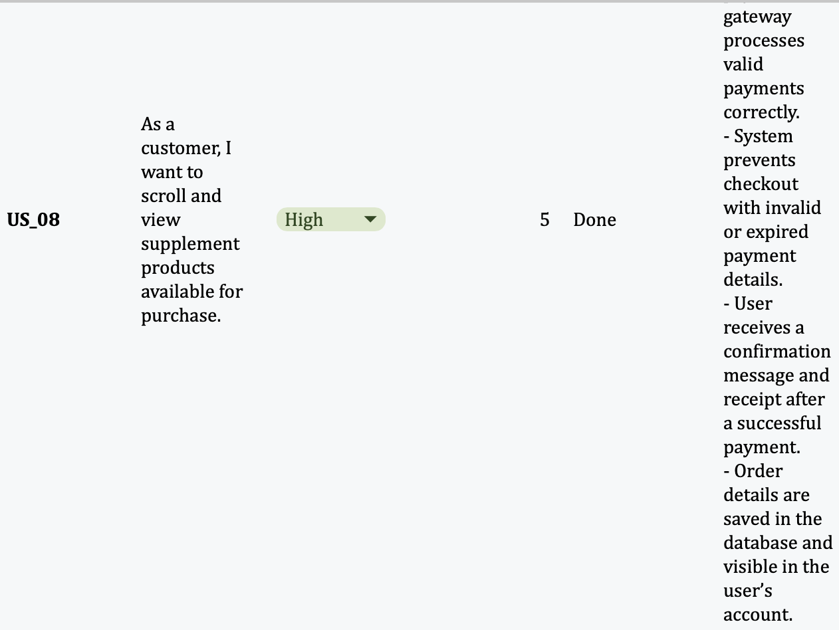
Sprint Backlog Pt.8

Slide 28
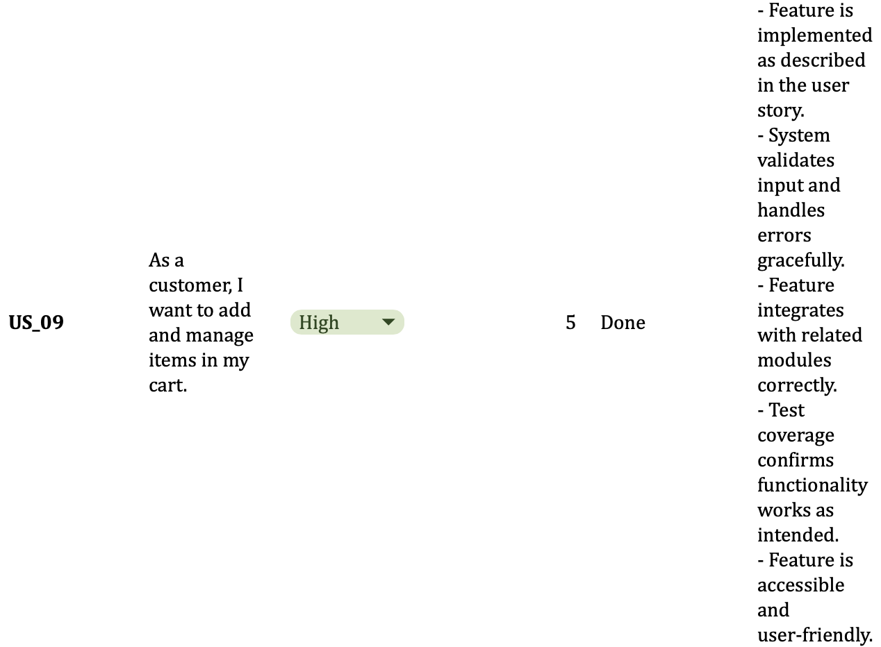
Sprint Backlog Pt.9

Slide 29
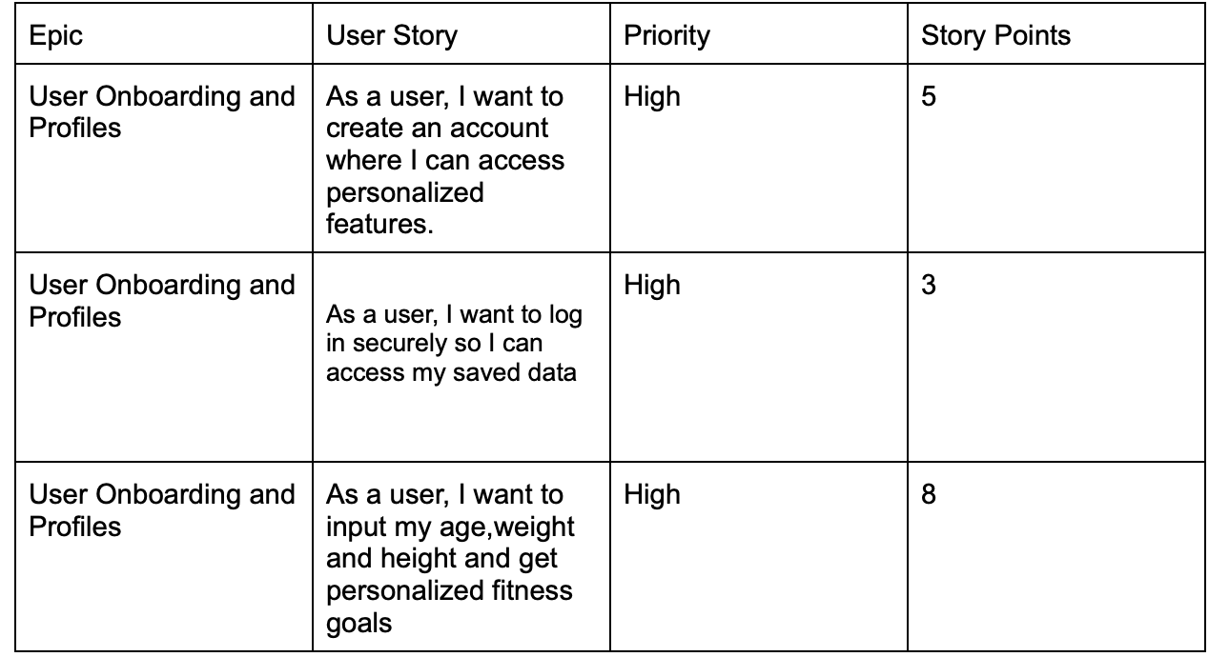
Product Backlog pt.1

Slide 30
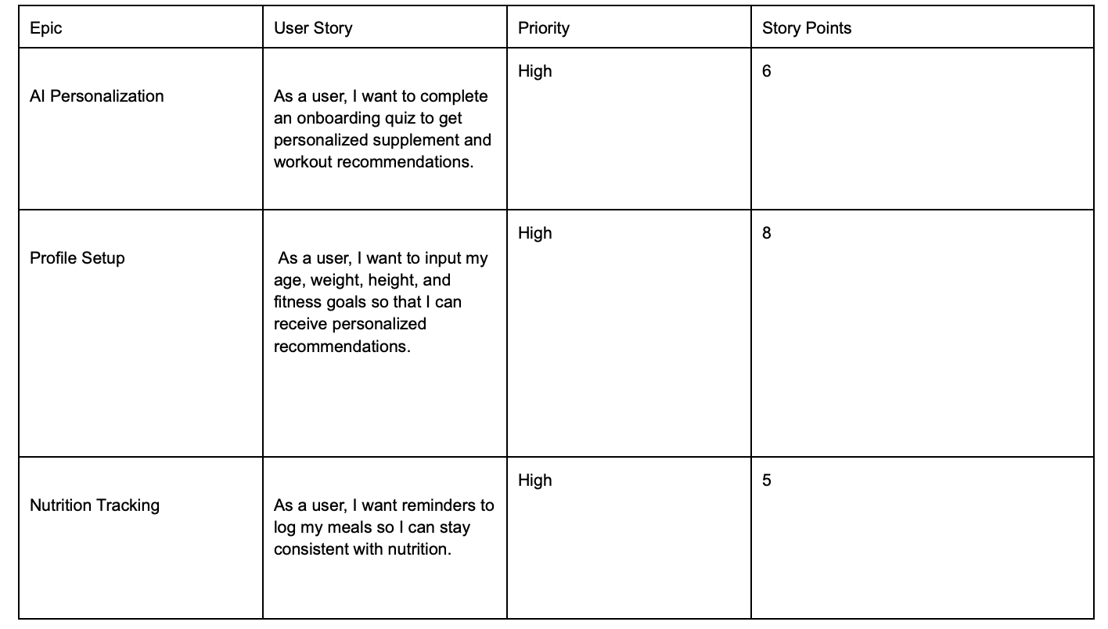
Product Backlog pt.2

Slide 31
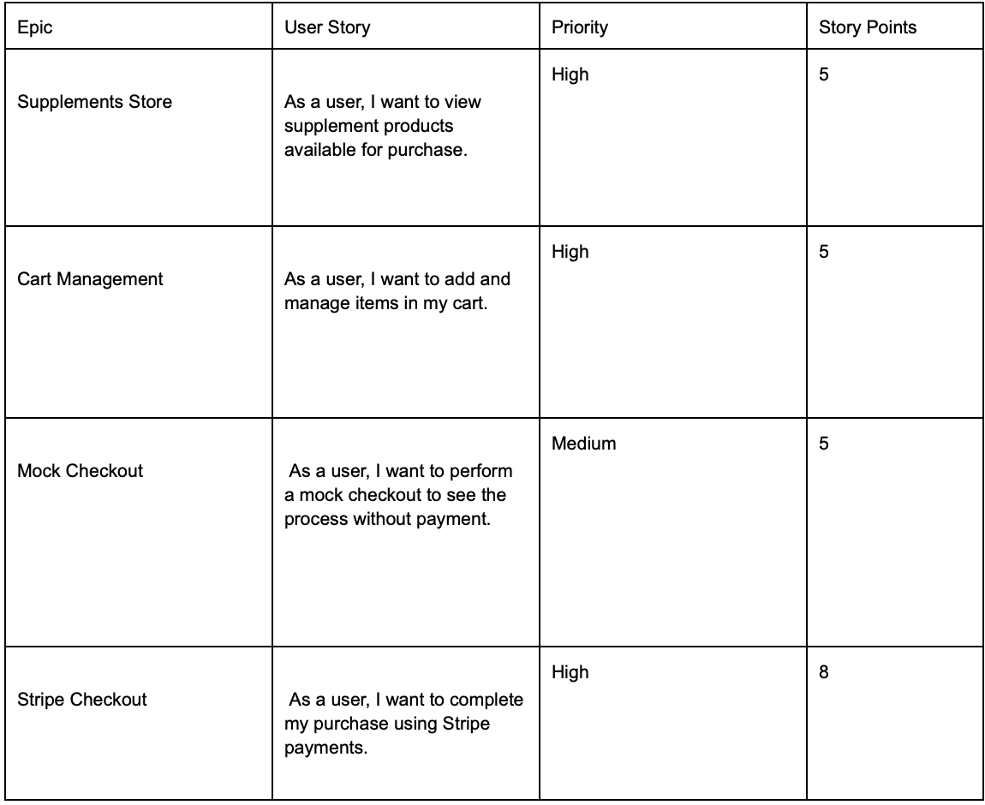
Product Backlog pt.3

Slide 32
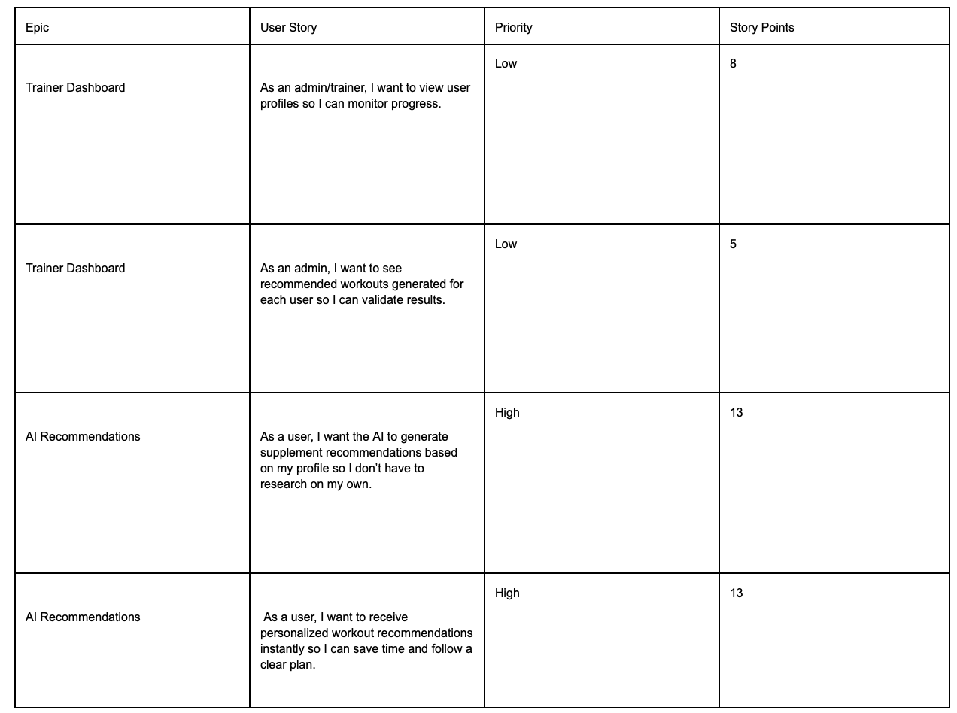
Product Backlog pt.4

Slide 33
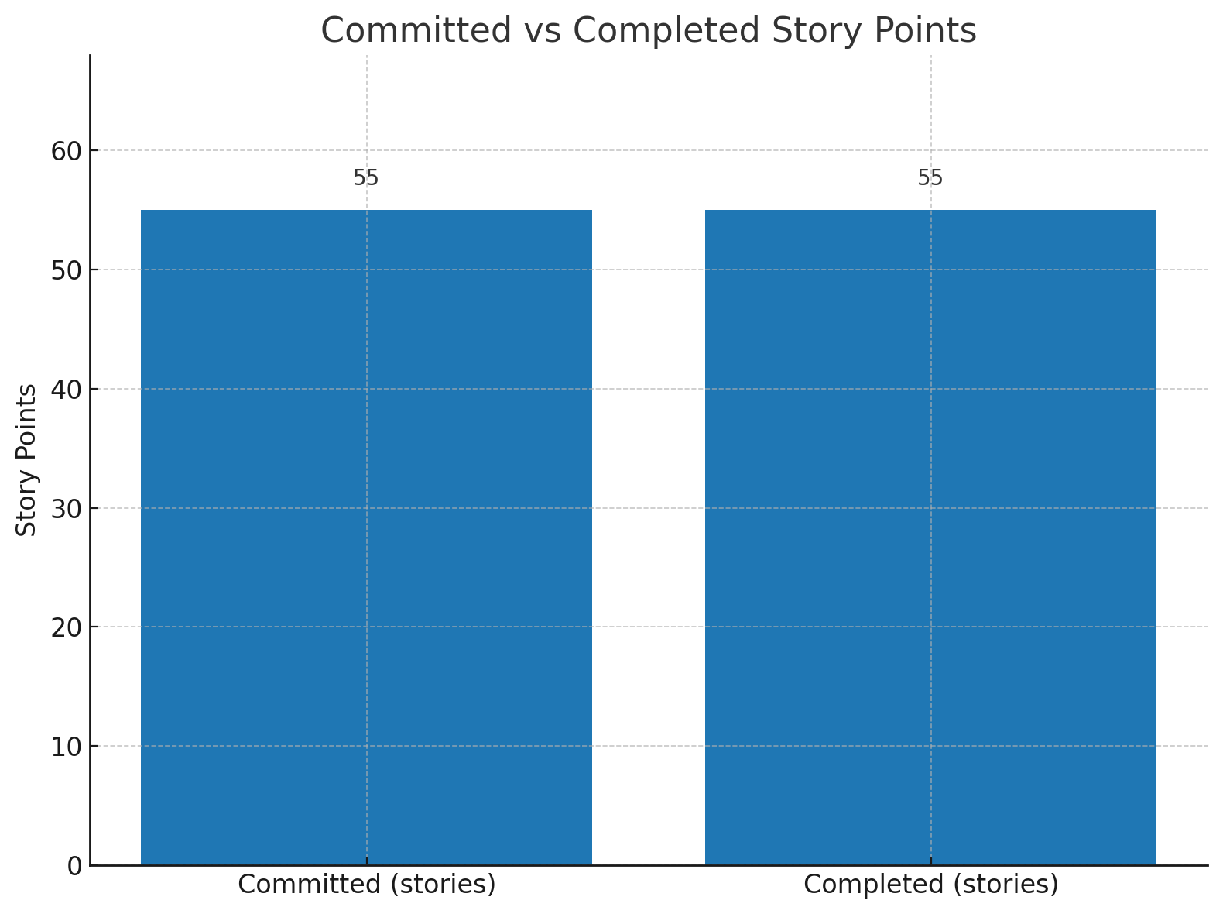
Velocity & Completed/Committed Ratio Chart
Total Story Points: 55
Story Points Completed: 55
Ratio: 55/55 = 100%

Slide 34
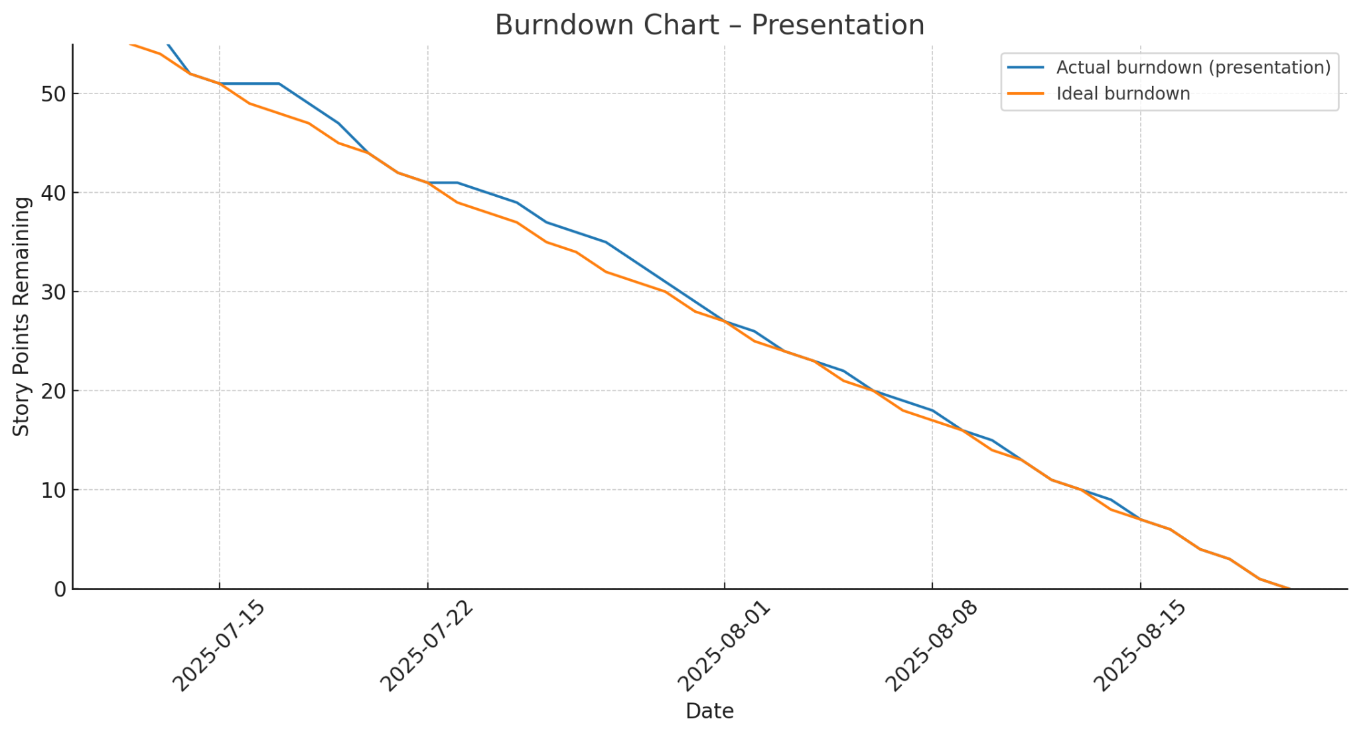
Burndown Chart

Slide 35
API
Stripe API
DeepSeek API
Type: REST API
Purpose: Loading checkout shop, and allowing users to purchase items listed in Stripe
How it works:
The application makes a POST request which allow users to checkout the item they want to purchase.
API being called is in StripeController with backend logic in StripeService
Type: REST API
Purpose: Analyzes users information such as age,weight,height and generating a workout based on user input.
How it works:
The application will read the user’s information from the frontend and it will be sent through a prompt to the API. The generated workout is then retrieved.

Slide 36
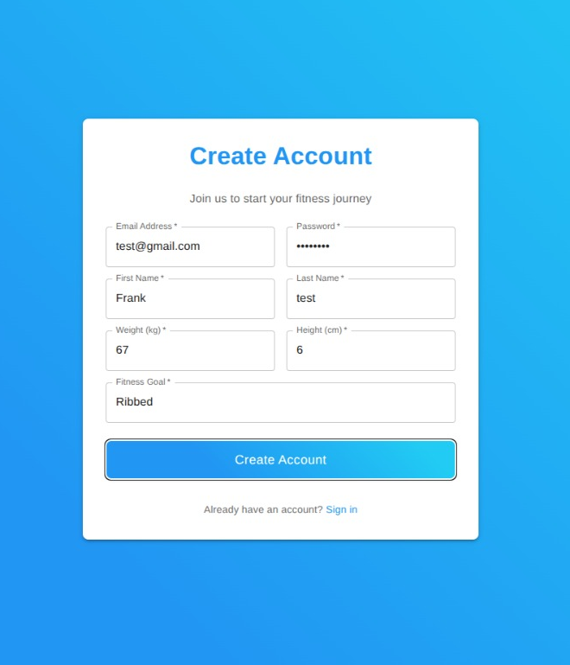
APP
CREATING AN ACCOUNT
A first time user registers their account on the app before signing in.
Once inside the app, a user can navigate to a supplements store where they can select items on the screen and add them to a cart.
Once satisfied they open the cart and pay the online checkout.

Slide 37
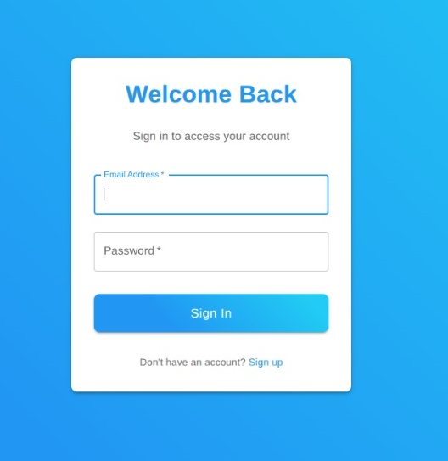
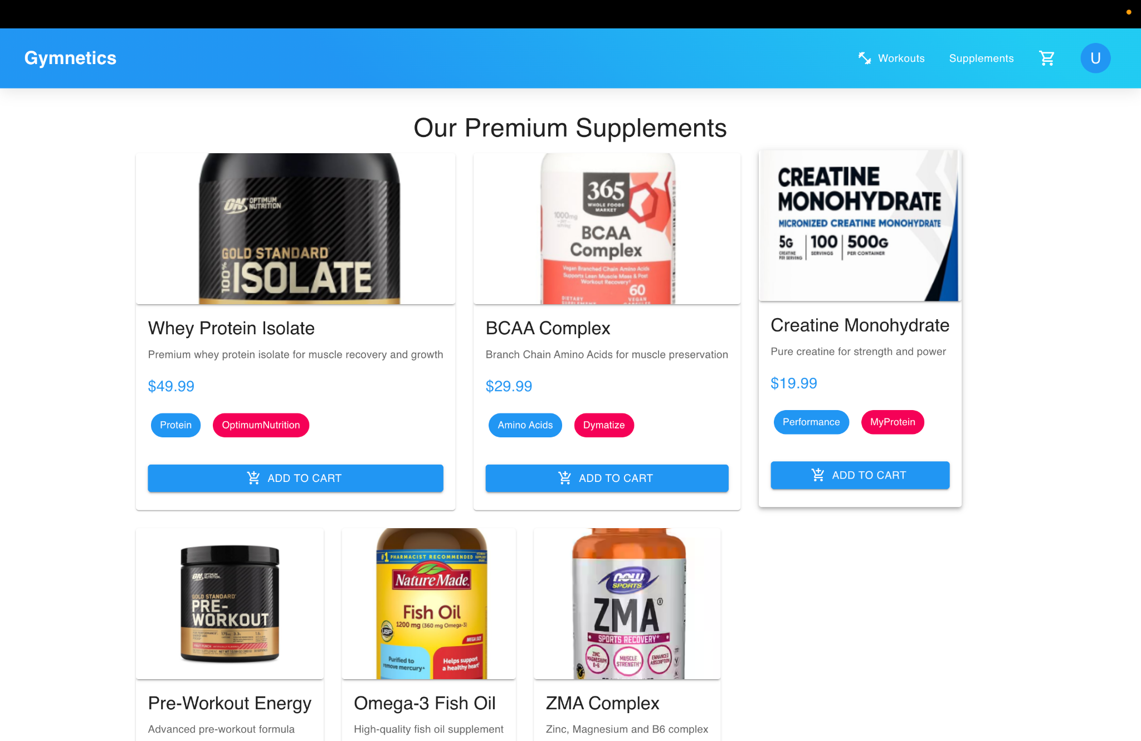
SIGNING IN
SUPPLEMENTS STORE

Slide 38
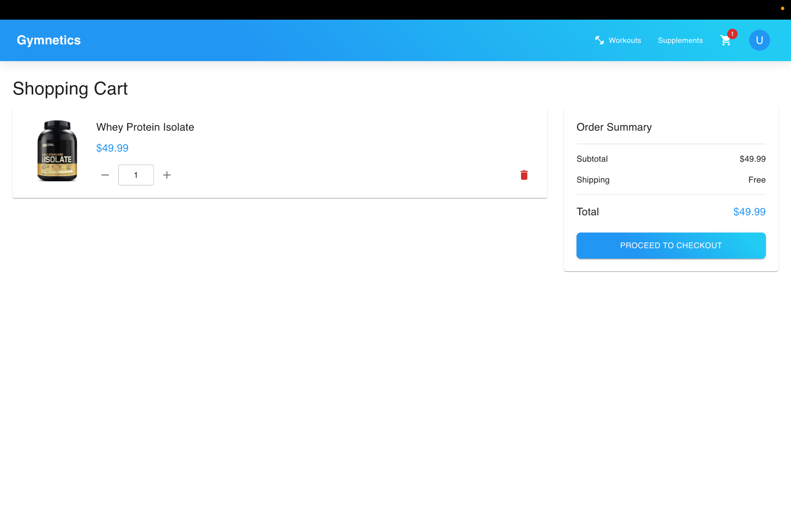
CHECKOUT

Slide 39
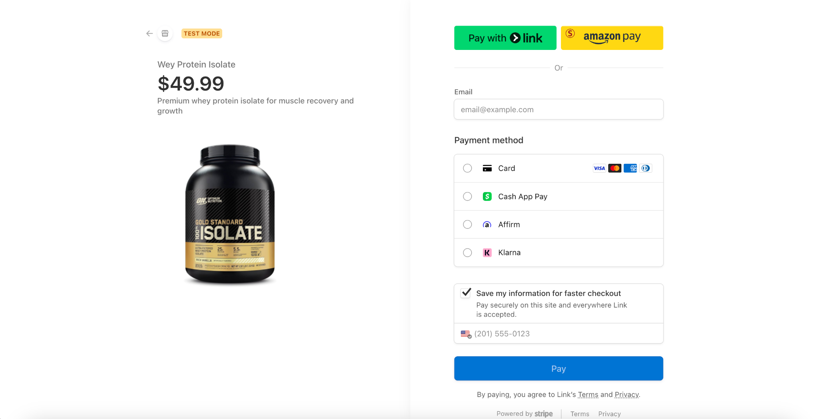
CHECKOUT

Slide 40
THANK YOU
https://github.com/htmw/2025Su-ByteSquad/wiki

